Slide 1
Reflective Decoding Network for Image Captioning
Lei Ke et al. iccv 2019

Slide 2
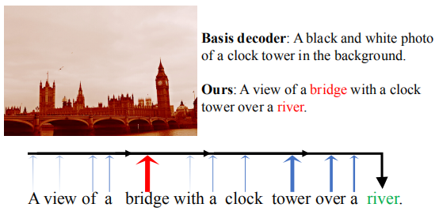
Problems
long-term dependency problem
Notes:
Current mainstream caption decoder (The traditional LSTM model) is weak in handling this kind of long-term dependency in sequential sentence,

Slide 3
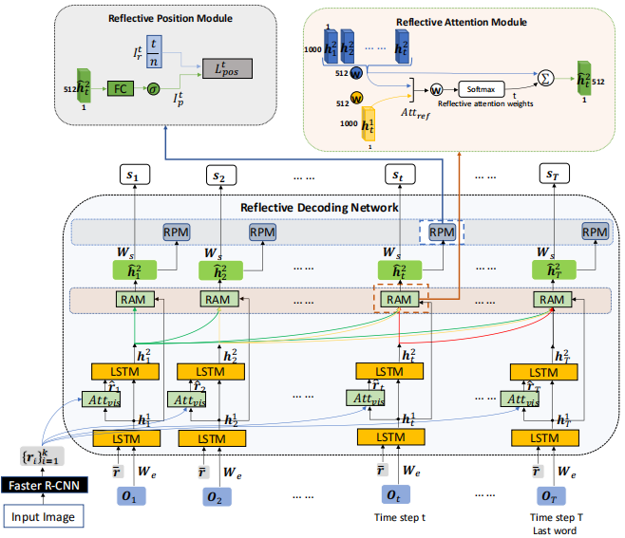
Reflective Decoding Network
Notes:
Attention-based Recurrent Module: to selectively attend to the detected regional features.
Reflective Attention Module: to model the compatibility between current and past decoding hidden states.
Reflective Position Module: to perceive the syntactic structure of sentences.
utilize the annotated object and attribute data from the VGto pretrain the object-level encoder

Slide 4
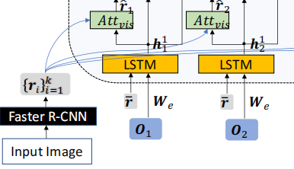


Attention-based Recurrent Module
LSTM layer:
Att_{vis} layer:

Slide 5
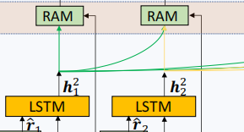
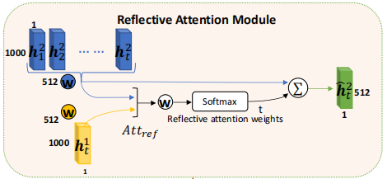

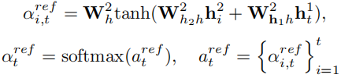


Reflective Attention Module
second LSTM layer:
Att_{ref} layer:

Slide 6
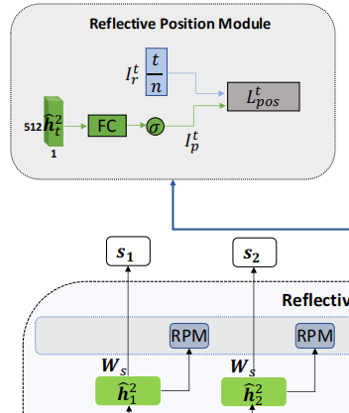

Reflective Position Module
I_{r}^{t} : actual relative position
I_{p}^{t} : predicted relative position
n : the length of the sentence
aims: minimize the difference between I_{r}^{t} and I_{p}^{t} by designing a loss function.
n is needed, so this is a supervised way. when in the inference phase, RPM should be ignored, because n is unknown and This module has no effect on generating captions.

Slide 7



Training
cross entropy loss
the Position-Perceptive loss
all loss

Slide 8
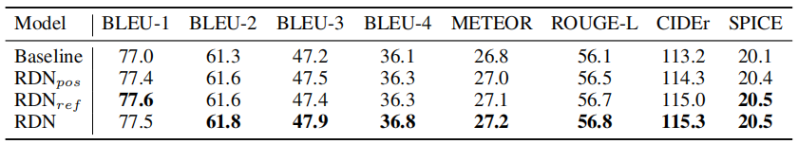
Ablation study
Baseline: the baseline denotes the RDN without Reflective Attention Module and Reflective Position Module

Slide 9
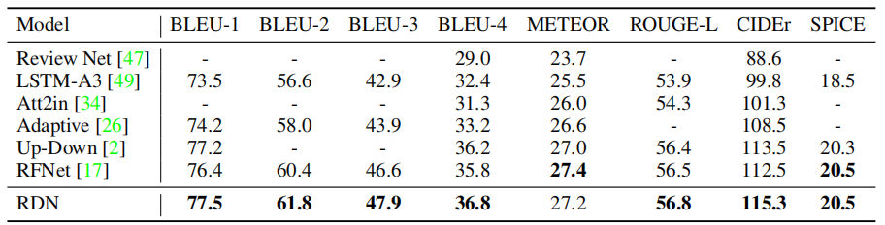
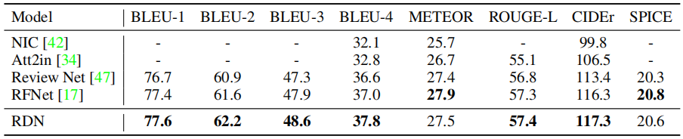
Results
Single model
ensembling

